Slide 1
Client context and our objectives
BASIC MATERIALS (GEM) | ASIA-PACIFIC
BAS022
Client context
Approach
Impact
Title
Client is part of a promoter led USD 1.5 bn conglomerate with businesses spread across electricals, infra, auto and IT
Client is the group’s building materials company with annual turnover of USD 150 mn (80% of which is from a single SBU)
We have been working in a partnership with the client for the last 2.5 years focussing on sales transformation
FY 2014 was a bad year with market contracting for the first time in a decade
Despite multiple attempts earlier, organisation was struggling to provide adequate focus to new products
There was high attrition at top leadership and in sales organisation
Create an organisation structure which facilitates growth of multiple products
Provide fillip to primary business and accelerate sales growth in other business
Move to a low-cost manufacturing base
Create institutional capability (e.g., sales academy) for impact sustainability
Client name: X
Team set-up: X
Fees Structure: X
What was unique: X

Slide 2
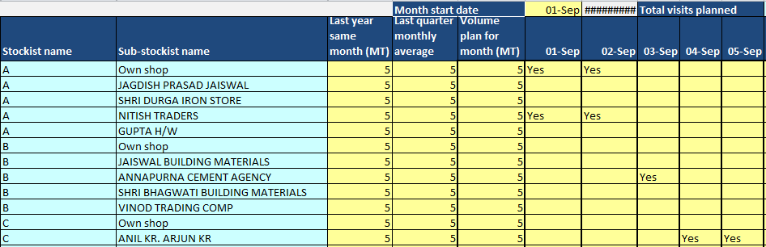
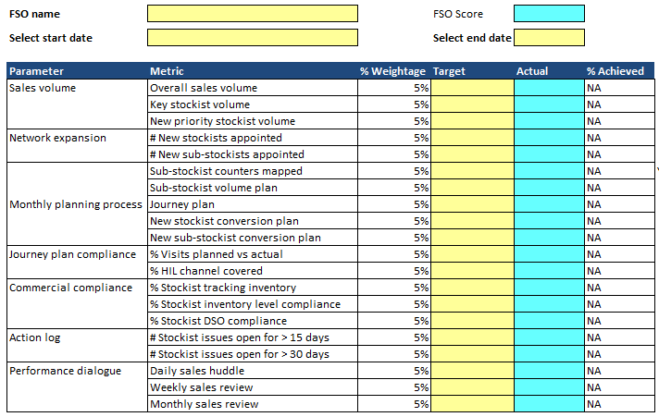
Sales academy - key process changes and enablers put in place
Monthly sales planning
FSO / SH performance score card
Sub-stockist level granular sales and journey plan for the month
Balanced score-card to track FSO / SH performance on input as well as output metrics
FSO log book
Review cadence
Enabler to help FSO execute channel partner related roles (order taking, inventory stock, issue recording)
Review architechture to track module implementation and success

